Slide 1
British Airways
Customer ratings analysis and insights
2022-11-09

Slide 2
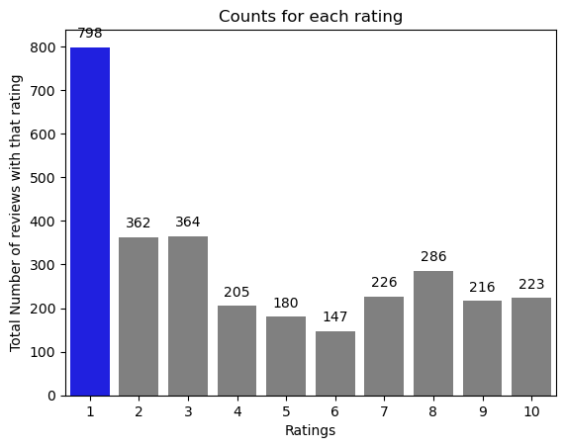
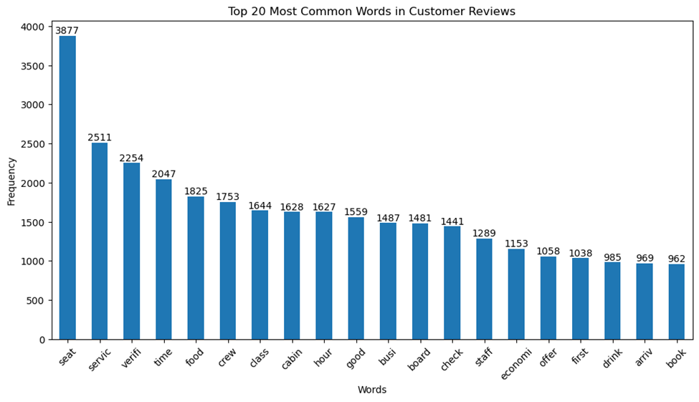

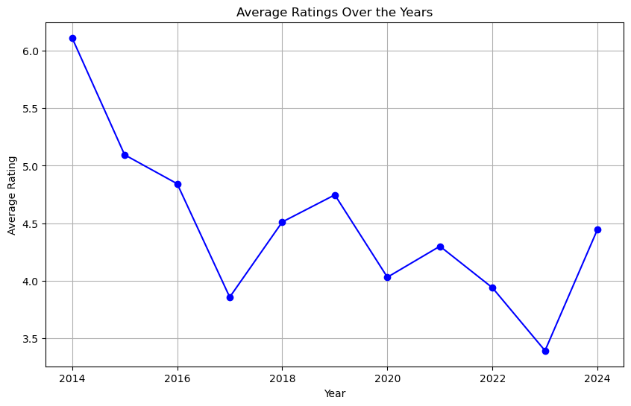
Key metrics
3007 Total reviews
collected
Reviews from 69 Countries
Country with highest Reviews
United Kingdom
Average Overall Rating
4.41 /10
All Customers liked cabin crew service and staff, general economy seats. Many travelled in Business class.
Focus on – Business class service, seats, improve inflight entertainment experience, checking in process. Enhance the experience of business class, it seems customers want value for money. Improve Customer service on refund requests and process.
What customers are happy and unsatisfied about for different ratings class:
Good ratings wrote about comfortable seats, good inflight entertainment, good food quality, early arrival and departure, and friendly staff.
Avg. ratings had issues with a small entertainment screen, long passport check queue, bad business class experience, and late flight.
Bad ratings wrote dissatisfaction on congested middle seat, business class experience, small screen, seats and the food (cold).

